Slide 1
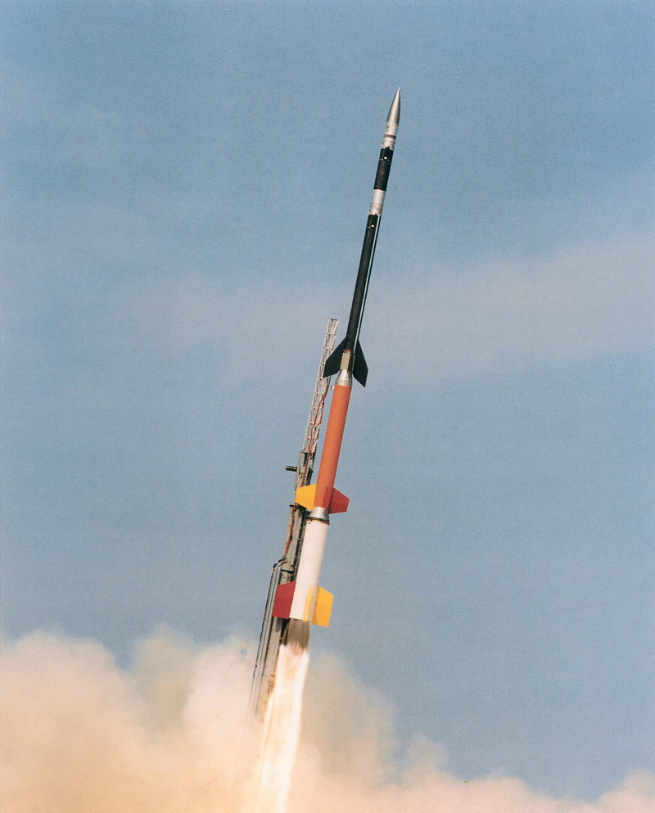
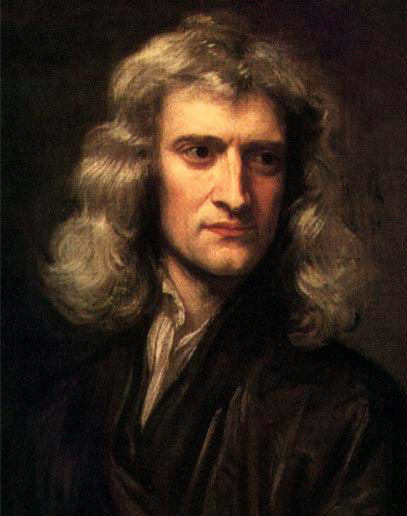
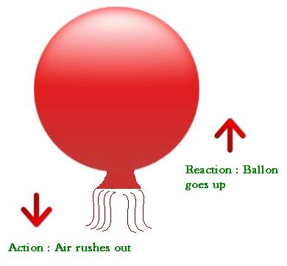
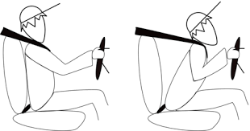
Newton’s 3 Laws of Motion
Newton’s 3 Laws Summary
Newton’s First Law
Applications
Newton’s Second Law
Second Law Simulation
Newton’s Third Law
Applications
Many opportunities for students to check their understanding

Slide 2
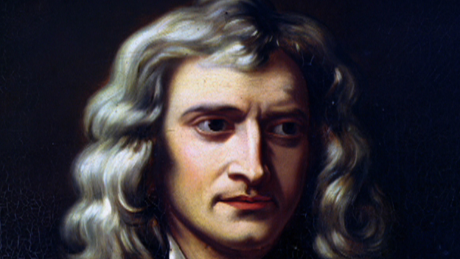
Newton’s Laws of Motion
a.k.a. The Law of Inertia: If the net force acting on an object is zero, that object maintains its state of rest or constant velocity.
An object accelerates in the direction of the net force. The acceleration is directly proportional to the net force and inversely proportional to the object’s mass.
For every action force, there is a simultaneous reaction force equal in magnitude but opposite in direction.
Newton’s (N) as a unit of Force
N = kg m/s²

Slide 3
Newton’s First Law of Motion
a.k.a. The Law of Inertia: Things want to keep doing what they are doing.
Stationary objects don’t want to move
Moving objects don’t want to stop moving
To cause acceleration—the net force acting on an object cannot be zero.

Slide 4
Newton’s First Law of Motion
This law has several important implications.
An external force is required to change the velocity of an object.
For an object to change velocity (including changing from v = 0), the F_{net} must be greater zero in one direction.
Objects at rest remain at rest unless acted upon by an external F_{net} greater zero.
Moving objects continue to move in a straight line at a constant speed unless acted upon by a net external force.

Slide 5
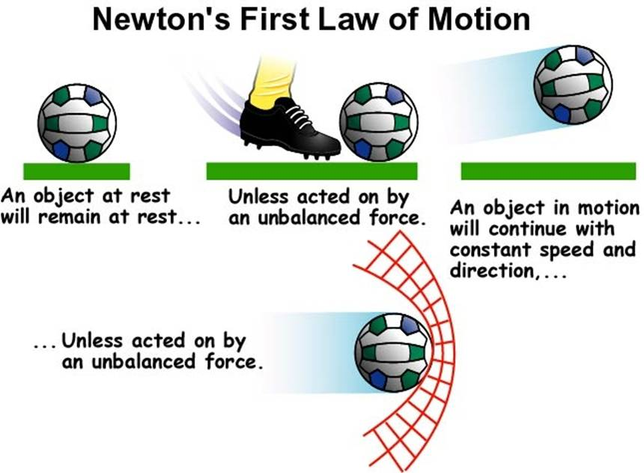

Slide 6
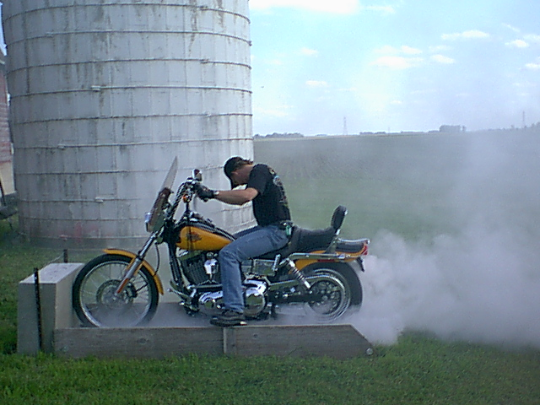
When net force is zero…

Slide 7
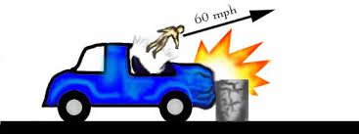
Application
An example occurs when a car slows down quickly; the people in the car tend to continue moving forward, possibly crashing their heads into the windshield if they are not wearing a seat belt. The seat belt prevents them from shooting forward through the windshield
An airbag acts in a similar fashion to stop the person from hitting their head on the dashboard or steering wheel during a front-end collision.
Both act to reduce the inertia experience by the passengers.

Slide 8
Check Your Understanding
You exert a force of 45 N [up] on your backpack, causing it to move upward with a constant velocity. Determine the force of gravity on the pack.
Answer: F_{g} = 45 N [down]

Slide 9
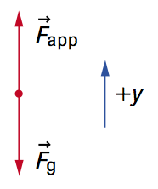
Check Your Understanding Solutions
The FBD of the pack (right) shows that two forces act on the pack: the applied force (F_{app}) that you exert and the force of gravity (F_{g}) that Earth exerts. Since the pack is moving at a constant velocity, the net force must, by the law of inertia, be zero. So the upward and downward forces have the same magnitude, and F_{g} = 45 N [down].

Slide 10
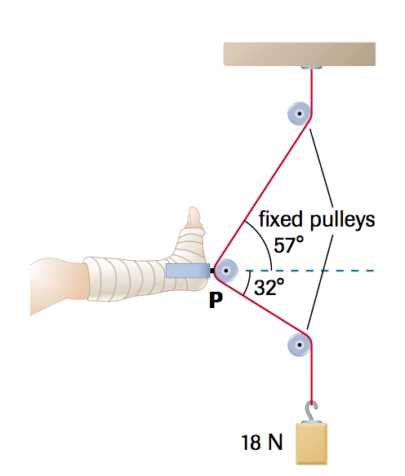
Check Your Understanding
The traction system below stabilizes a broken tibia. Determine the force of the tibia on the pulley. Neglect friction.
Hint: A traction system is meant to create a F_{net} = 0 so that the leg doesn’t move.
Answer: F_{tibia} = 26N [left 13° down]

Slide 11
Newton’s Second Law of Motion
An object accelerates in the direction of the net force. The acceleration is directly proportional to the net force and inversely proportional to the object’s mass.
F = ma → a = F
m
Acceleration increase as F increases
Acceleration decreases as m increases

Slide 12
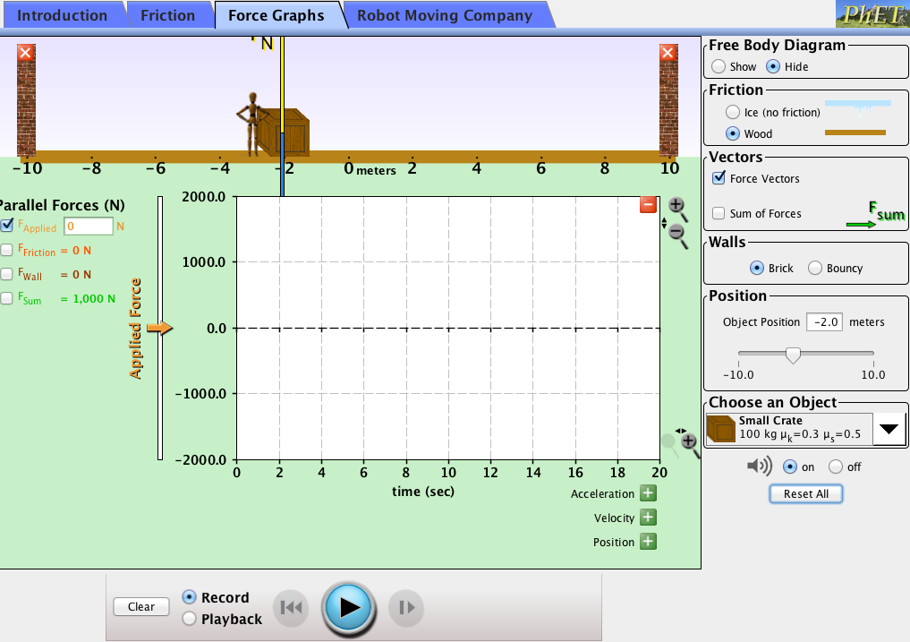
Newton’s Second Law Demonstration
Record the accelerations for the 50, 100 and 200 kg objects using a force of 1000 N.
Perform the calculations yourself using F = ma for each mass.
What can you conclude about how a changes as mass changes? What kind of relationship exists?

Slide 13
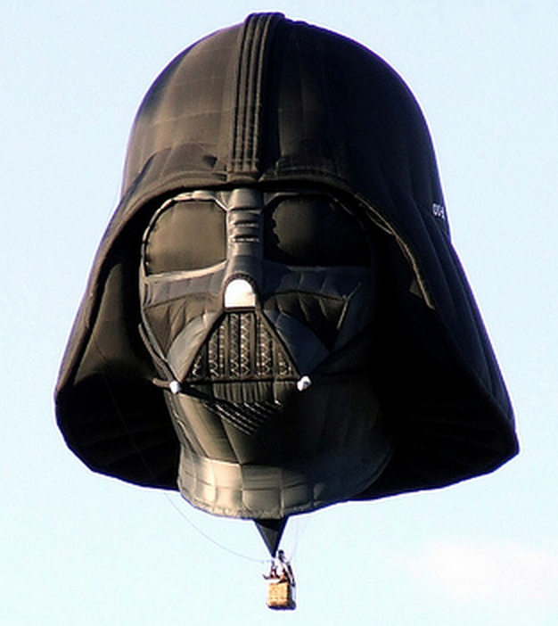
Check Your Understanding
The mass of a hot-air balloon, including the passengers, is 9.0 x 10² kg. The density of the air inside the balloon is adjusted by adjusting the heat output of the burner to give a buoyant force on the balloon of 9.9 x 10³ N [up]. Determine the vertical acceleration of the balloon.

Slide 14
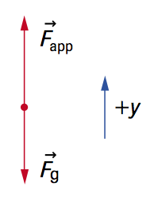
Check Your Understanding Solution
F_{net} = F_{app} – F_{g} = 9900 N – 8820 N = 1080 N
a = F_{net}/m = 1080 N / 900 kg = 1.2 m/s² [up]

Slide 15
Check Your Understanding
A net force of 58 N [W] is applied to a water polo ball of mass 0.45 kg. Calculate the ball’s acceleration.
Answer: 1.3 × 10² m/s² [W]

Slide 16
Check Your Understanding
In an extreme test of its braking system under ideal road conditions, a Toyota Celica, travelling initially at 26.9 m/s [S], comes to a stop in 2.61 s. The mass of the car with the driver is 1.18 × 10³ kg. Calculate
the car’s acceleration.
the net force required to cause that acceleration.
Answer: a) 10.3 m/s² [N] b) 1.22 × 10⁴ N [N]

Slide 17
Newton’s Third Law of Motion
For every action force, there is a simultaneous reaction force equal in magnitude but opposite in direction.
For every action, there is an equal and opposite reaction
When a balloon is inflated and released, air rushing from the open nozzle causes the balloon to fly off in the opposite direction

Slide 18
Application
As the rocket pushes the fuel out the back, the fuel pushes back on the rocket to move the rocket forward
This even occurs in space where there isn’t any air to push against

Slide 19
Newton’s 3rd Law

Slide 20
Check Your Understanding
A contractor is pushing a stove across a kitchen floor with a constant velocity of 18 cm/s [fwd]. The contractor is exerting a constant horizontal force of 85 N [fwd]. The force of gravity on the stove is 447 N [down].
Determine the normal force (F_{N} ) and the force of friction (F_{f} ) acting on the stove.
Determine the total force applied by the floor (F_{floor}) on the stove.
Answer: a) FN = 447 N [up] Ff = 85 N [backwards] b) F_{floor} = 455 N [fwd 79° up]

Slide 21
Check Your Understanding
Sleds A and B are connected by a horizontal rope, with A in front of B. Sled A is pulled forward by means of a horizontal rope with a tension of magnitude 29.0 N. The masses of A and B are 6.7 kg and 5.6 kg, respectively. The magnitudes of friction on A and B are 9.0 N and 8.0 N, respectively. Calculate the magnitude of the acceleration of the two-sled system.
Answer: a = 0.98 m/s²

Slide 22
Check Your Understanding
At an indoor skating rink children skate with their parents. Behind each child, a parent, also on skates, prepares to push horizontally to see who can push their child the farthest. In this competition, a certain mother has a mass of 61 kg, and her daughter a mass of 19 kg. Both skaters experience negligible. At the starting bell, the mother pushes the child with a constant applied force of magnitude 56 N for 0.83 s. Determine the magnitude of
the daughter’s acceleration.
the mother’s acceleration.
the maximum velocity of the daughter.
Answers: a) a_{d} = 2.9 m/s² b) a_{m} = is 0.92 m/s² c) V_{f} daughter = 2.4 m/s

Slide 23
Let’s Summarize

